Slide 1
Meeting Agenda Overview
Data for current modelling paper
BIG synbio experiment for next modelling paper
Minimal community?
Mark Mimee probabilistic activation of acetate machinery?
Diving into more secondary metabolites for other organisms?
Discuss potential direction for next funding callout – one potentially in December, but not necessarily

Slide 2
Batch Metabolic Modeling
Scope
The story of the paper is that a new metabolic phenotype switching-based model has been developed that can accurately simulate dynamic metabolic interactions within and between organisms
Still need to do
Biolog plates to test metabolic model accuracy on different carbon sources
Grow various cocultures and send different time points for metabolomics
Workup metabolomics data and make sure modeling team is set up for success
Write “why these organisms/metabolites” section into the already made draft – what organisms have been used by similar models?
Write methods sections for the experiments
(Done, but need to add specifics like exact Hidex model and E. coli strain)
Timeline
Is completely finished on my end unless further experiments are needed. ETA is dependent on modeling and extra experiments needed

Slide 3
Metabolomics data – Acetate dynamics
% EC
50%
56%
84%
80%
50%
38%
77%
71%
Note – OD over time is roughly 0.1 at 0h; 0.3 at 4h; 2.0 at 12h; and 3 at 24h
Results:
In all cases excess acetate peaks at 8 hours and is completely consumed by 24h
The presence of P. fluorescens alters acetate dynamics in all cases
P. fluorescens decreases acetate accumulation in the absence of 4HB
P. fluorescens delays acetate accumulation and consumption in the presence of 4HB

Slide 4
Metabolomics data – Acetate dynamics
Results:
Both E. coli and P. fluorescens can consume acetate completely by 24h of growth
P. fluorescens consumes acetate much faster than E. coli in the presence of Maltose
P. fluorescens do not produce any acetate from consuming 4HB
Conclusions:
P. fluorescens appear to have carbon source preferences at different timepoints
P. fluorescens are consuming enough acetate to grow (mM concentrations)

Slide 5
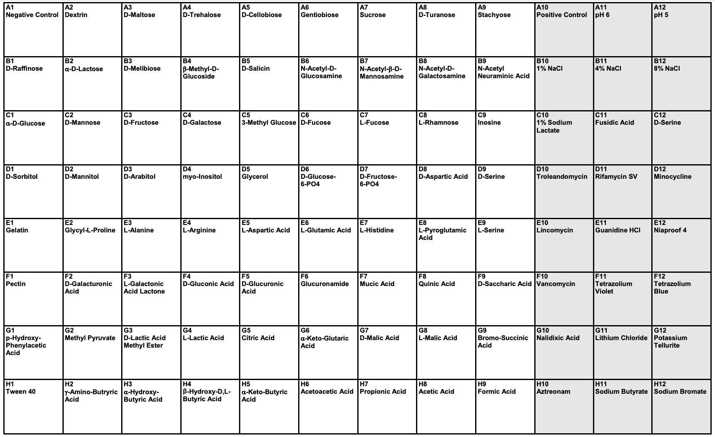
Gen III microplate data

Slide 6
Gen III microplate data
24h timepoint
D-Arabitol only in coculture?

Slide 7
Engineering/Chemostat Metabolic Modeling
Scope
Dynamic metabolic model that was just published can also be adapted to chemostat growth environments and metabolic engineering - MORE TBD based on results/timeline…
Need to do now
Do full range of growth assays with different carbon sources and cocultures with E. coli, ACS E. coli, KOs strains, and PF
Test HosA and homologues in PF and EC w/ different 4HB concentrations and different DNA binding sites to compare to northwestern results
Need to figure out
BIG synbio experiment: 4HB activates ACS expression, ACS replaces GFP or RFP in probabilistic system from Mark, others? Need a clear goal first
Timeline
Ideally, in the next 5-7 months we’ll at least have a concrete draft and all data. Depends on BIG synbio experiment and how much followup we need to do (transcriptomics, metabolomics, etc.)

Slide 8
Important callout elements
“Omic-based information” “Fundamental principles that allow scaling and modeling beyond molecular realm”
“Microbial interactions in natural environments” “environmental change” “long-term change” “realistic recapitulations of microbial ecosystems” “interactions translate to ecosystem properties across scales” “iterating among lab and natural systems”
“Applications that leverage high-throughput cultivation and reconstruction of microbial communities to reconcile observed, environmental community behavior are welcome”
“carbon sequestration, GHG emission, nutrient cycling” “Manipulate environmental microbiomes for the purpose of understanding and predicting their behavior” “as well as soil carbon storage”

Slide 9
Important callout elements
“Omic-based information” “Fundamental principles that allow scaling and modeling beyond molecular realm”
“Microbial interactions in natural environments” “environmental change” “long-term change” “realistic recapitulations of microbial ecosystems” “interactions translate to ecosystem properties across scales” “iterating among lab and natural systems”
“Applications that leverage high-throughput cultivation and reconstruction of microbial communities to reconcile observed, environmental community behavior are welcome”
“carbon sequestration, GHG emission, nutrient cycling” “Manipulate environmental microbiomes for the purpose of understanding and predicting their behavior” “as well as soil carbon storage”

Slide 10
Soil phosphate: engineering microbial dynamics to study and manipulate environmental ecosystems

Slide 11
Assets in hand (could do next week)
Major – need to be included
Metabolic modeling of organism cocultures
Predictions for how to influence specific metabolic pathways
P. fluor. SBW25 – engineerable PGPR with endogenous organic acid production machinery, and phosphate-responsive genetic elements. Also, well studied genome to help with metabolic modeling
Landing pad in SBW25
Minor – could be included
4HB biosensor – environmentally (soil/plant) friendly trigger molecule
Robotic assay for microbial growth and fluorescence measurements
Chemostat experiments
Metabolomics at UC

Slide 12
Assets within reach (used previously or collaboration)
Argonne Resources
Root chips (Gyorgy)
Analysis of phosphate(?) in soil using x-ray (Ken Kemner)
Future automated discovery capabilities
Extramural Collaboration
EMSL ”omics” core (Available, but not contacted)
Probabilistic microbial differentiation (UC, Mimee)
Minimal rhizocommunity (Henry/Gyorgy knows composition)
Other PGPR with landing pads

Slide 13
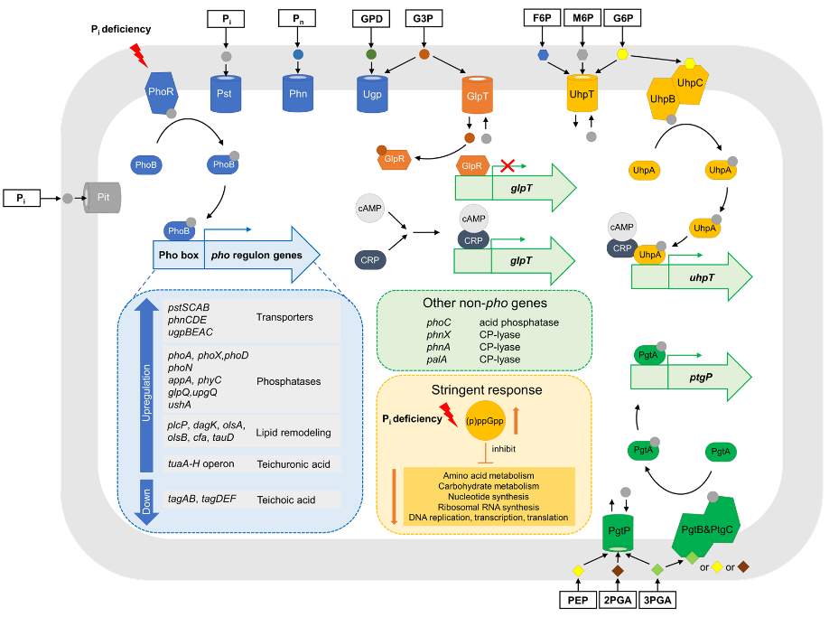
Assets needed
Environmental soil collection
Deep understanding of microbial phosphate regulation in soil/plant root
Environmental soil phosphate expert (NU, Aristilde)

